Slide 1
Specifying (and Testing) Relationships
CIDM 6330
Spring 2021

Slide 2
More on Abstractions
APP Chapter 3

Slide 3
Ranging from Concrete to Abstract
Your principal psychology is one of
Assessment
Classification
Abstraction
Problem discovery and solution is rooted in this

Slide 4
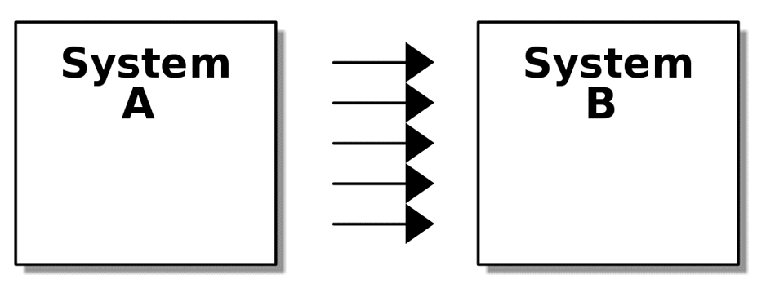
Elements of a system?

Slide 5
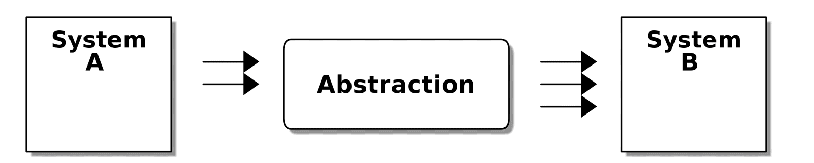
Cohesion and Coupling

Slide 6
Abstractions are testable
Broad expectations and inputs
Abstract implementation details
Stubs, Fakes and Mocks

Slide 7
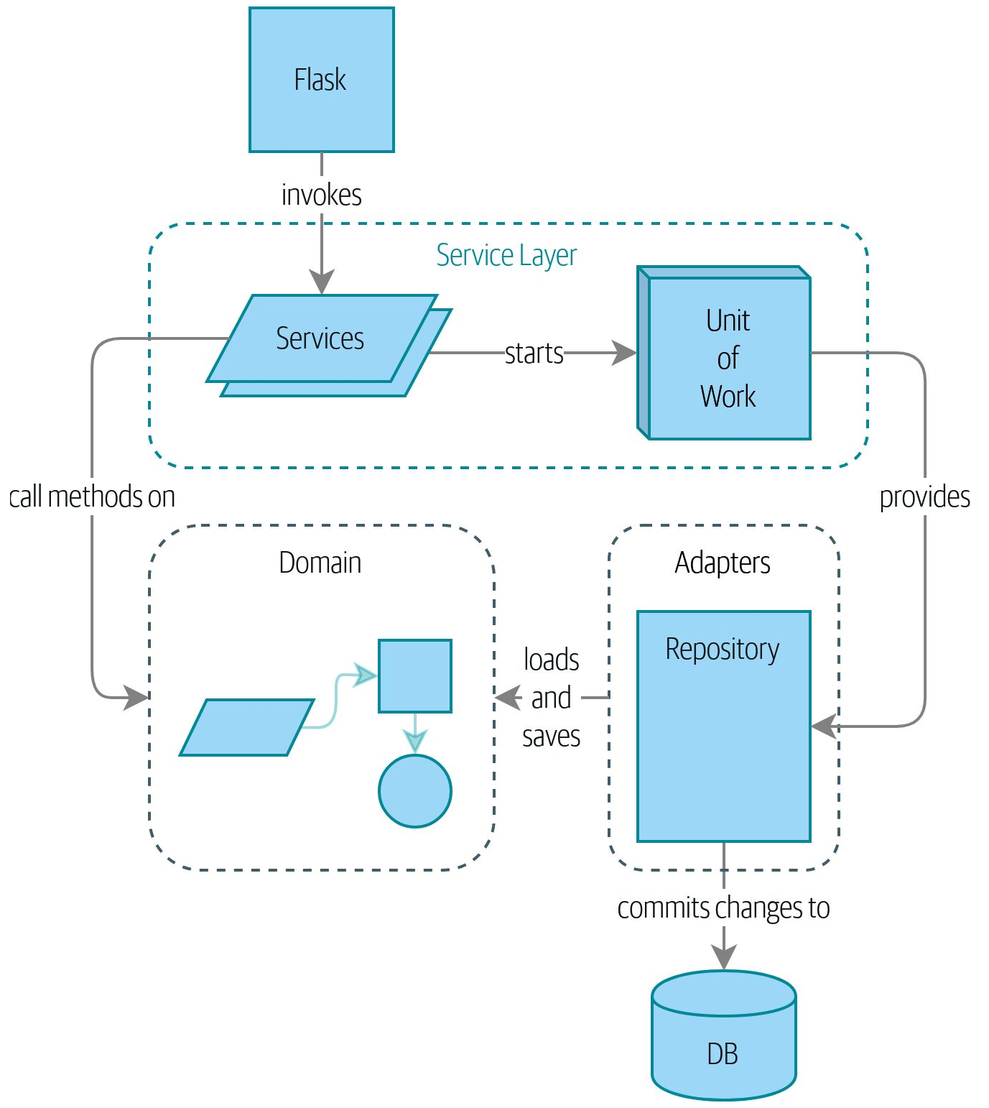
Roadmap

Slide 8
An Example Implementation
APP Chapter 4

Slide 9
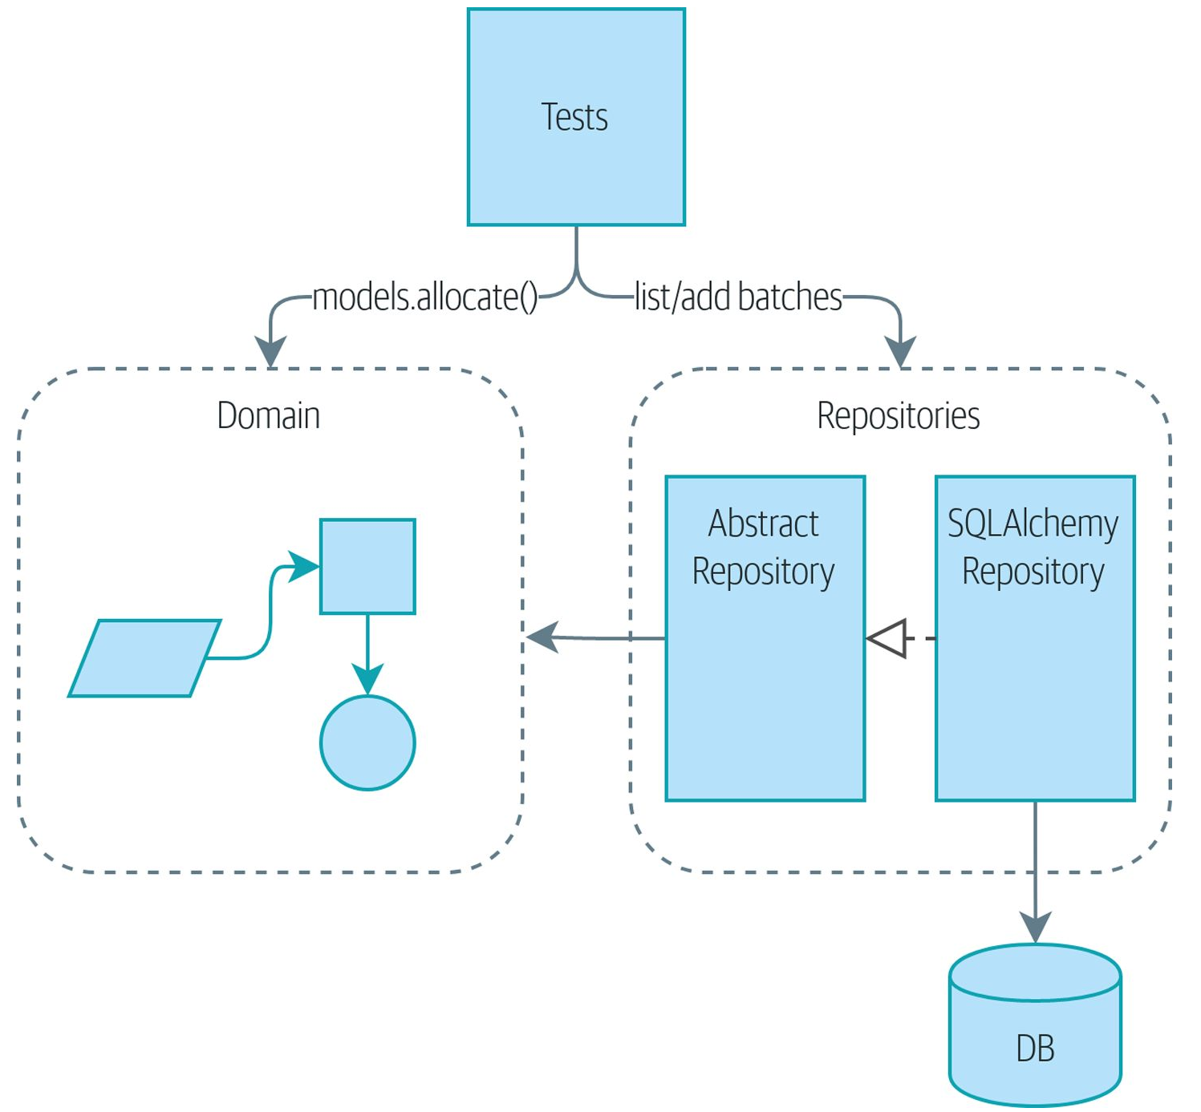
Example Application

Slide 10
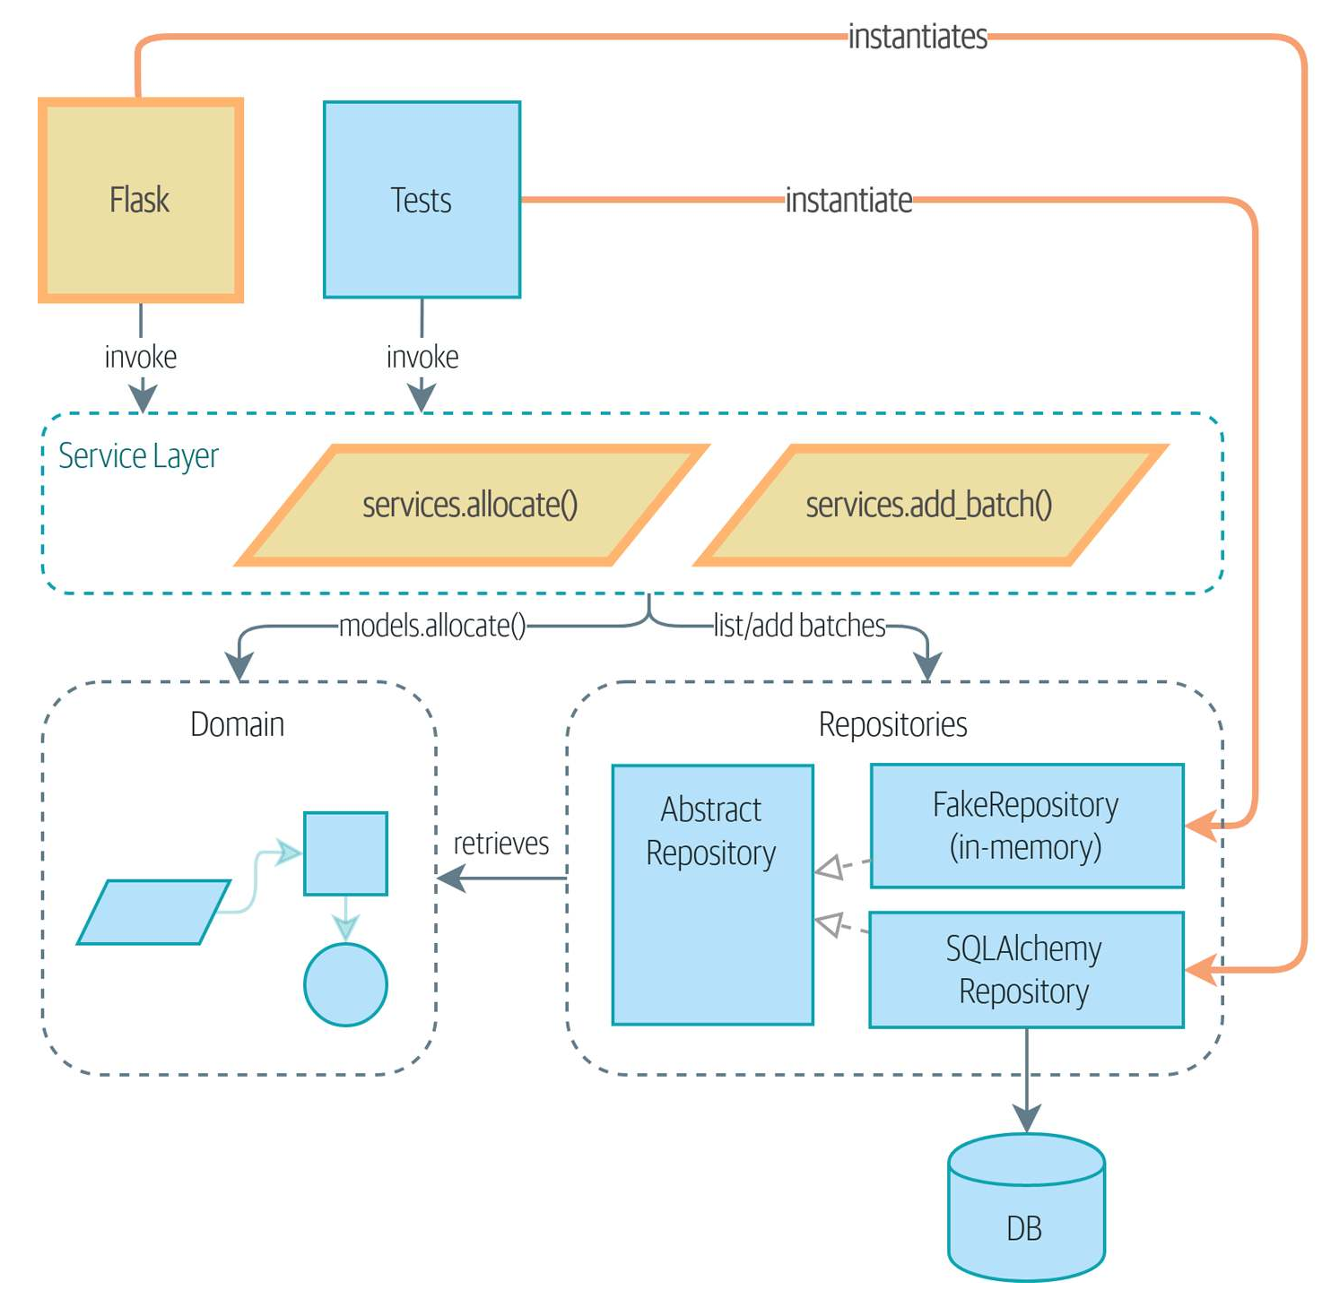
Introducing a Service-Layer

Slide 11
Components of an MVP
Using Flask
HTTP End Points
Flask to Domain Model connectivity
Decoupling the service and model layers

Slide 12
Nomenclatures
End to End (E2E testing)
Functional
Unit
Acceptance
Integration

Slide 13


Flask and SQLAlchemy
Flask
SQLAlchemy
A microservice HTTP/WSGI framework
A Python Object/Relational Mapper

Slide 14
A Service Orientation
Application Service
Handle outside requests
Orchestrate down-stream operations
Get data from persistence
Update domain models
Persist any state changes
Domain Service
Enforcement/accessing business logic and rules
Not attached to the state of a particular entity

Slide 15
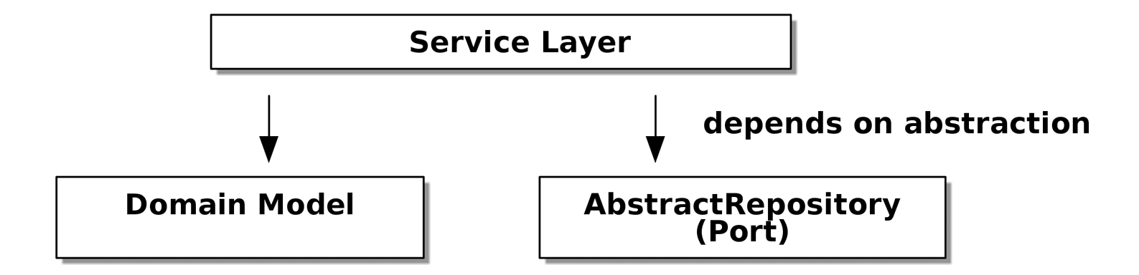
The Elaborated Architecture

Slide 16
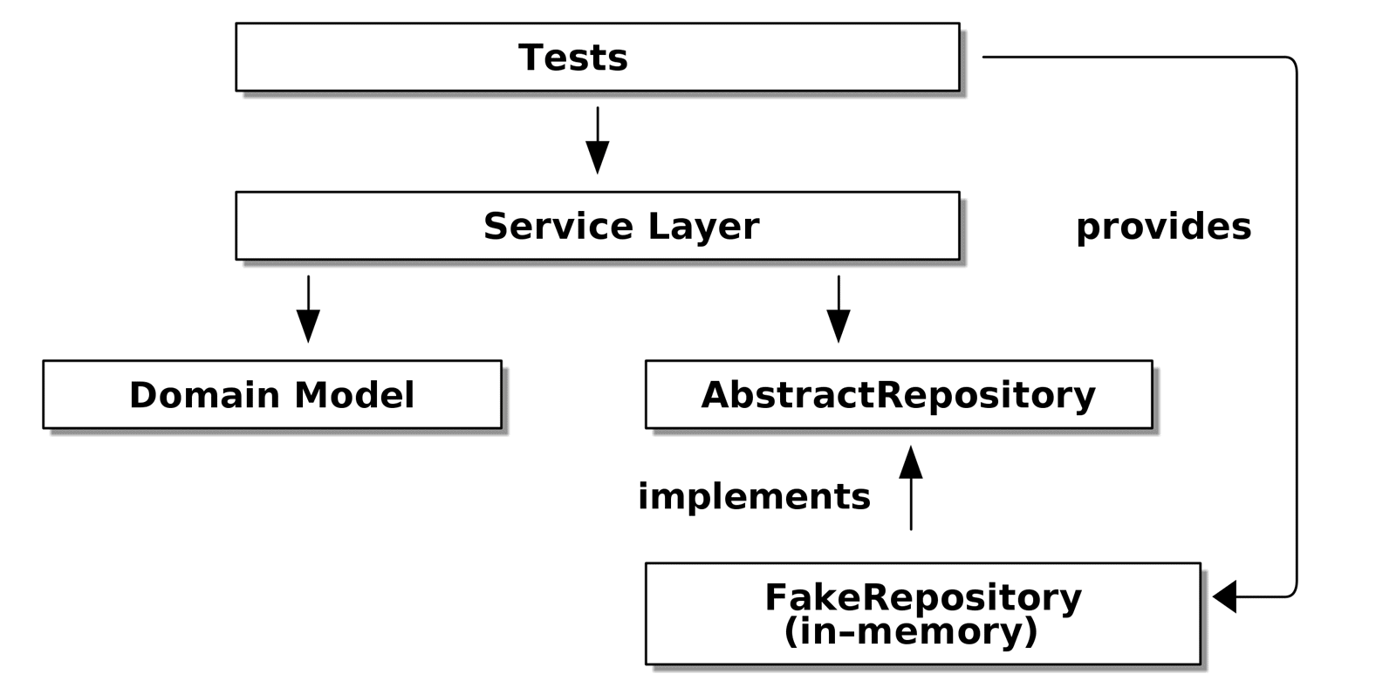
Locating Testing

Slide 17
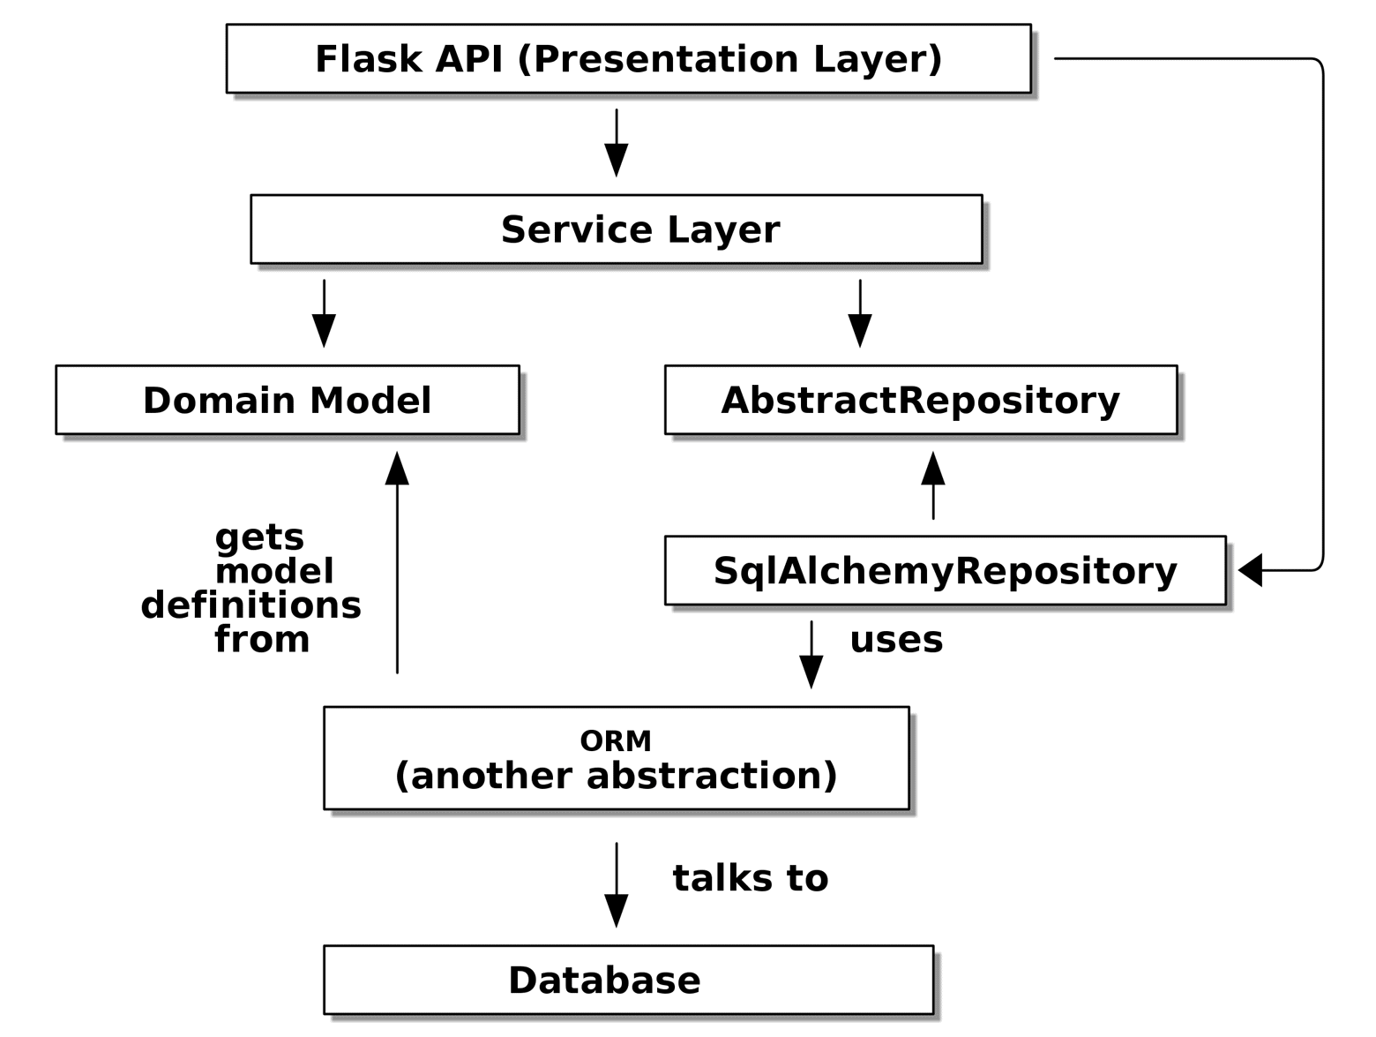
Flask/SQLAlchemy

Slide 18
Pros and Cons of Service Layers
Pro
Con
Colocation of use cases and logic
Domain logic details abstracted behind an API
Repository Pattern
Makes shifting between testing and production seamless
Too many layers?
Anemic Domains
We could just locate things in the domain services

